Slide 1


Vibration Signal Analysis for
Machinery Condition Monitoring
Authors:
Imre Kocsis,
Krisztián Deák
2022

Slide 2
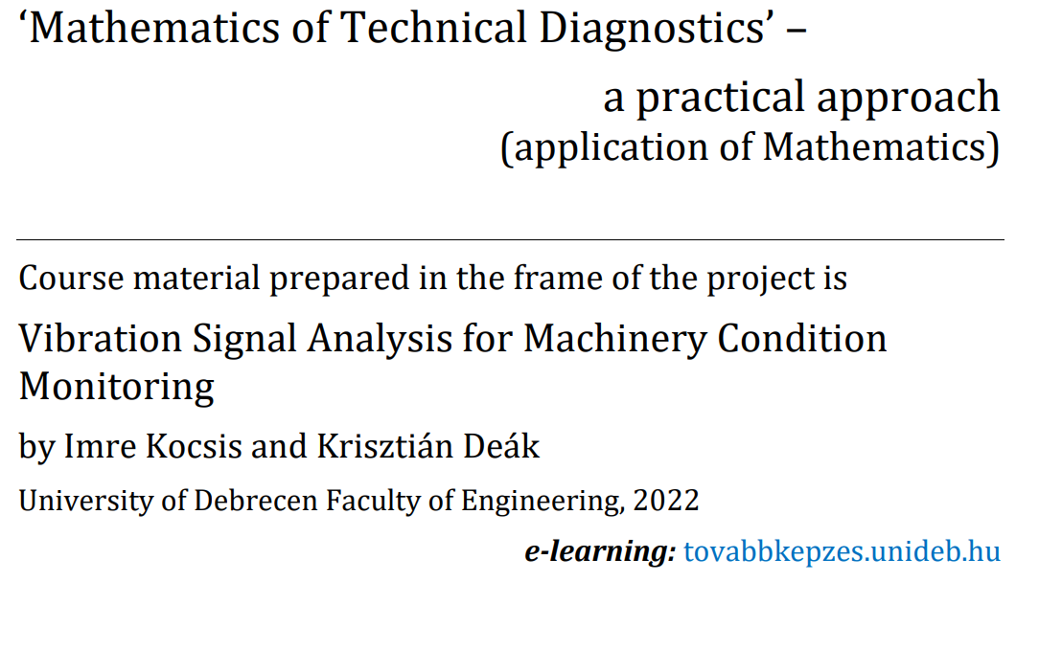
Vibration Signal Analysis for
Machinery Condition Monitoring
Authors:
Imre Kocsis,
Krisztián Deák
2022

Slide 3
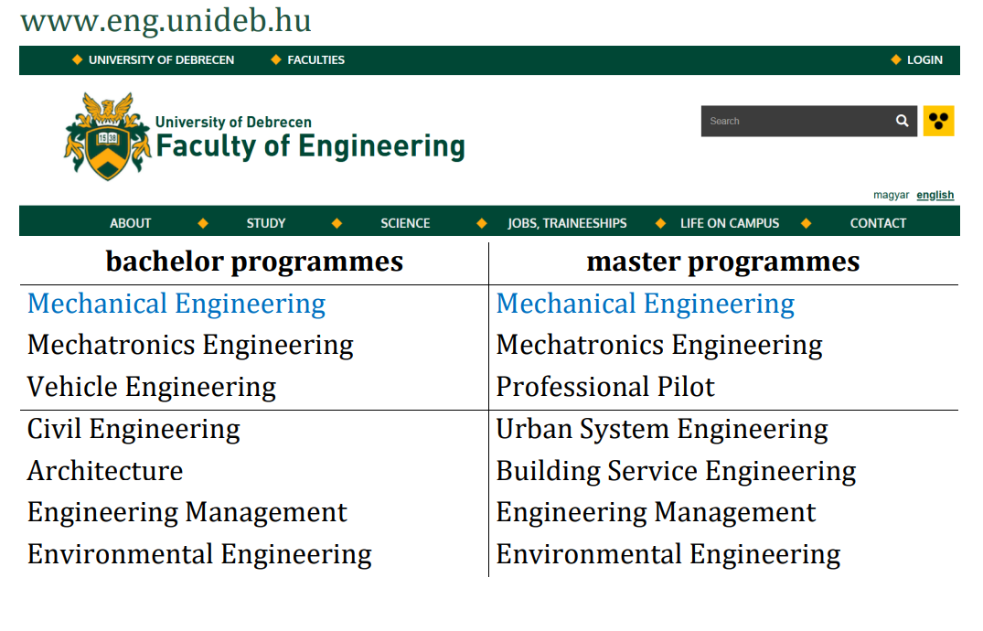
Vibration Signal Analysis for
Machinery Condition Monitoring
Authors:
Imre Kocsis,
Krisztián Deák
2022

Slide 4
Part I (Imre Kocsis)
1. Trigonometric and Exponential Functions
2. Statistical Analysis of Vibration Signals
3. Hilbert Spaces, Orthogonality, Similarity of Functions
4. Orthonormal Systems, Fourier Series, Trigonometric System
5. Exponential System, Vibration Spectrum
6. Continuous Fourier Transform, Discrete Fourier Transform, FFT
Part II (Krisztián Deák)
7. Cepstrum Analysis, Envelope Analysis
8. Continuous and Discrete Wavelet Transform
9. MRA, Scalogram
10. Wavelet Transforms in Machine Fault Diagnostics
11. Digital Filters, FIR, IIR
12. Digital Filter Design

Slide 5
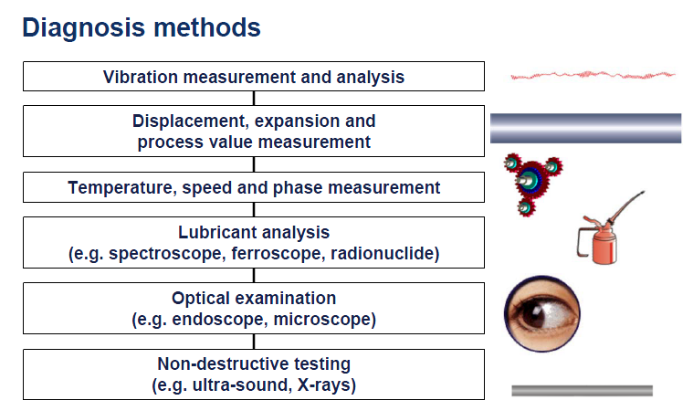

Slide 6
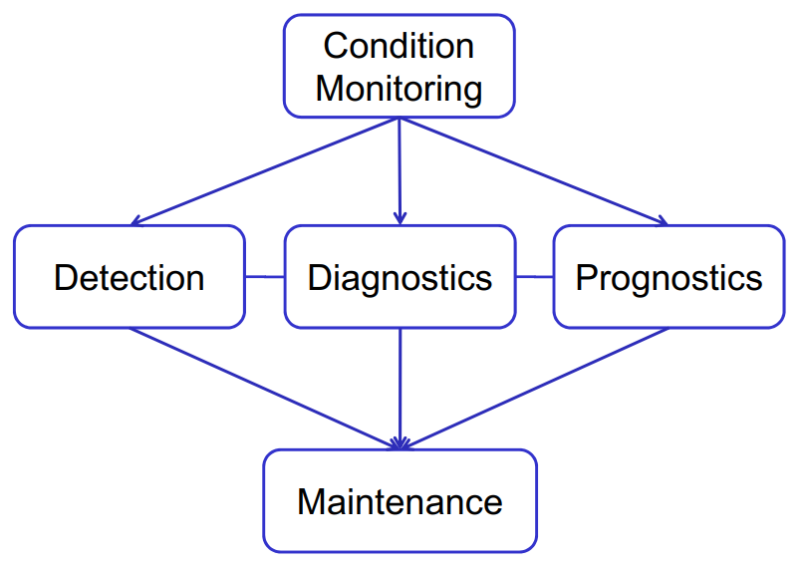

Slide 7
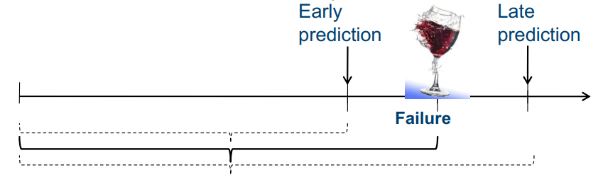
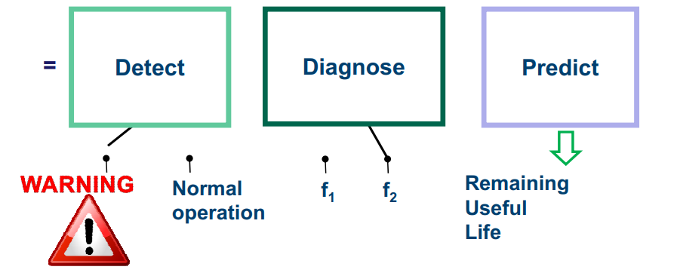

Slide 8
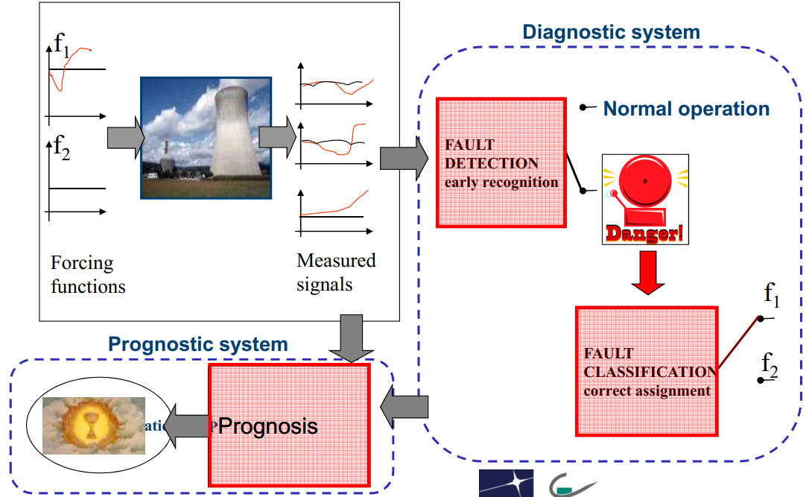

Slide 9
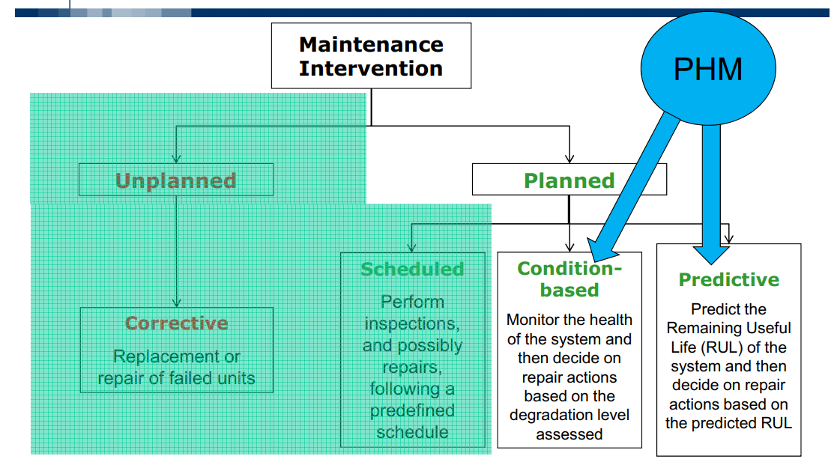

Slide 10
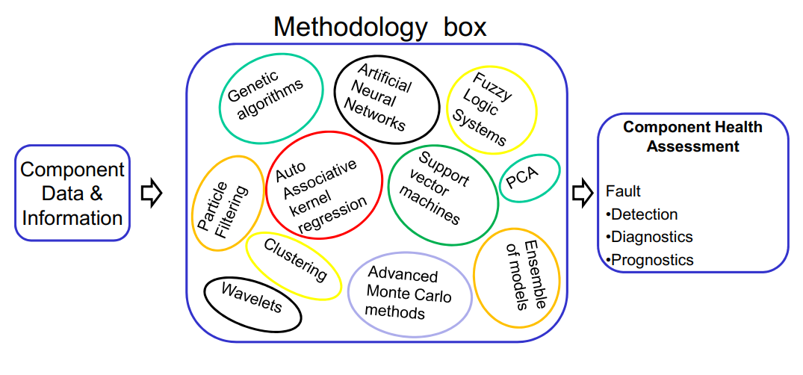

Slide 11
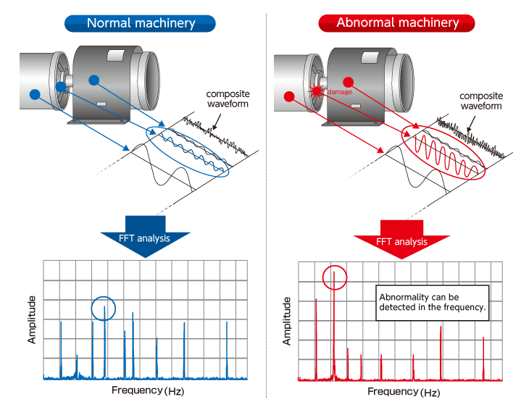

Slide 12
Fourier Transform
Fourier Transform reveals which frequency components are present in a given function.
(inverse DFT)
where:
(forward DFT)

Slide 13
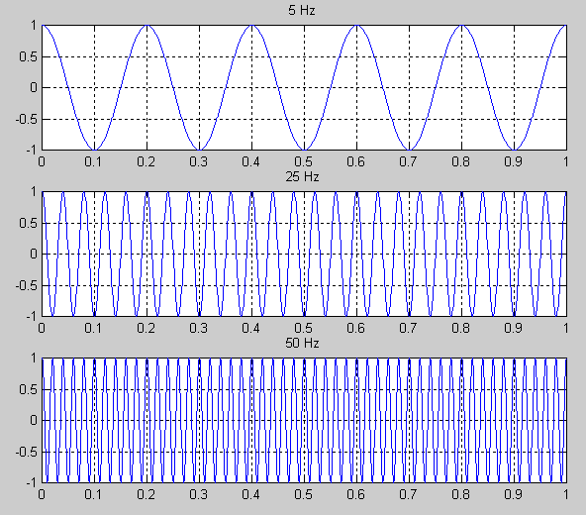
Examples

Slide 14
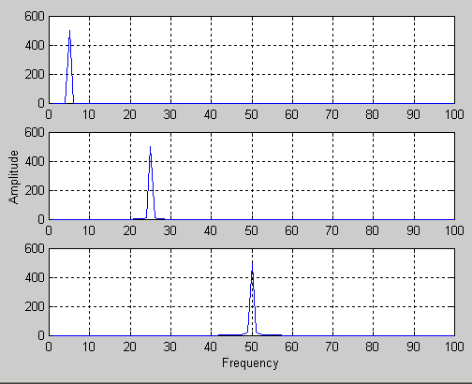
Examples (cont’d)
F₁(u)
F₂(u)
F₃(u)

Slide 15
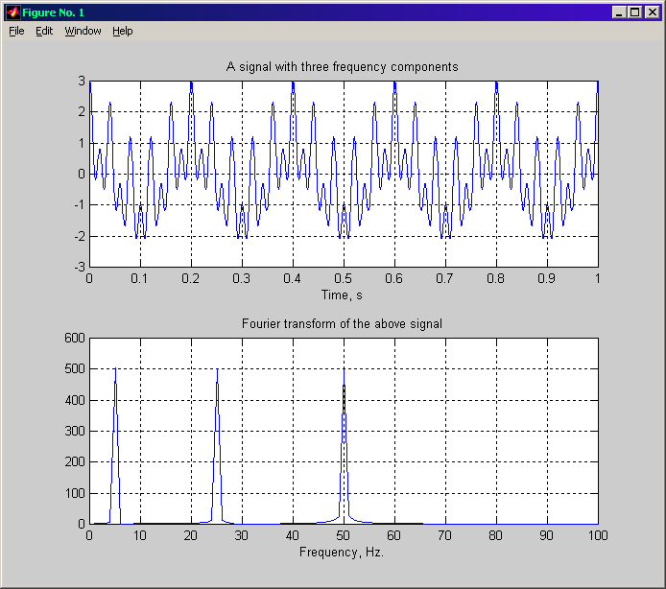
Fourier Analysis – Examples (cont’d)
F₄(u) ?

Slide 16
Limitations of Fourier Transform
1. Cannot not provide simultaneous time and frequency localization.
Poor localization in freq domain!
Great localization in freq domain!

Slide 17
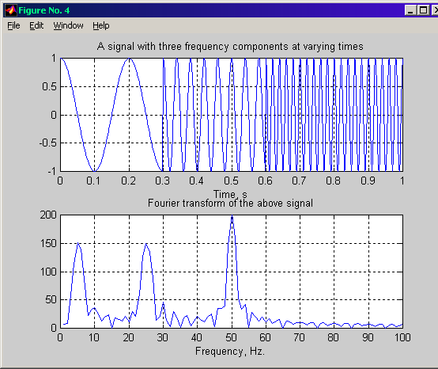
Limitations of Fourier Transform (cont’d)
2. Not very useful for analyzing time-variant, non-stationary signals.
Stationary signal
(non-varying frequency)
Non-stationary signal
(varying frequency)

Slide 18
Limitations of Fourier Transform (cont’d)
Three frequency components,
present at all times!
Three frequency
components, NOT present
at all times!
F₄(u)
F₅(u)
Perfect knowledge of what frequencies exist, but no
information about where these frequencies are located in time!

Slide 19








Statistical feature extraction in time domain

Slide 20
Short Time Fourier Transform (STFT)
Segment signal into narrow time intervals (i.e., narrow enough to be considered stationary) and take the FT of each segment.
Each FT provides the spectral information of a separate time-slice of the signal, providing simultaneous time and frequency information.

Slide 21
STFT - Steps
(1) Choose a window of finite length
(2) Place the window on top of the signal at t=0
(3) Truncate the signal using this window
(4) Compute the FT of the truncated signal, save results.
(5) Incrementally slide the window to the right
(6) Go to step 3, until window reaches the end of the signal

Slide 22
STFT - Definition
time
parameter
frequency
parameter
2D function
windowing
function
centered at t=t’

Slide 23
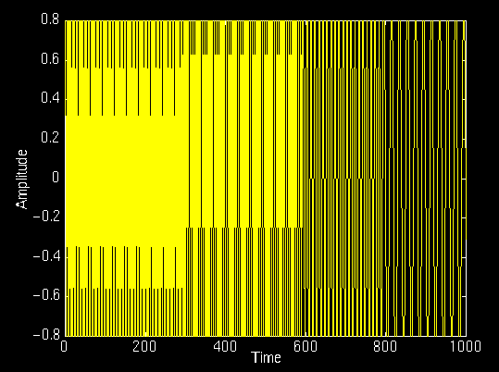
Example
f(t)
[0 – 300] ms → 75 Hz sinusoid
[300 – 600] ms → 50 Hz sinusoid
[600 – 800] ms → 25 Hz sinusoid
[800 – 1000] ms →10 Hz sinusoid

Slide 24
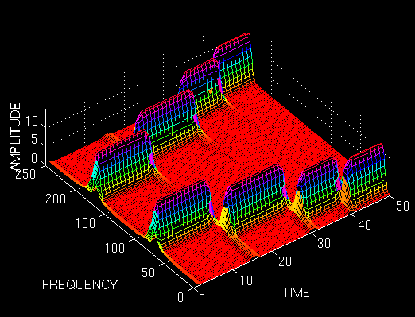
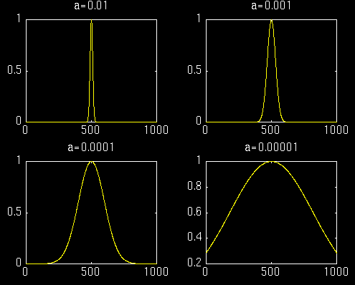
Example
f(t)
[0 – 300] ms → 75 Hz
[300 – 600] ms → 50 Hz
[600 – 800] ms → 25 Hz
[800 – 1000] ms →10 Hz
W(t)
scaled: t/20

Slide 25
Choosing Window W(t)
What shape should it have?
  Rectangular, Gaussian, Elliptic …
How wide should it be?
  Should be narrow enough to ensure that the portion of the signal falling within the window is stationary.
  Very narrow windows, however, do not offer good localization in the frequency domain.

Slide 26
STFT Window Size
W(t) infinitely long: → STFT turns into FT, providing excellent frequency localization, but no time localization.
W(t) infinitely short: → results in the time signal (with a phase factor), providing excellent time localization but no frequency localization.

Slide 27
STFT Window Size (cont’d)
Wide window → good frequency resolution, poor time resolution.
Narrow window → good time resolution, poor frequency resolution.

Slide 28
Example
different size windows
[0 – 300] ms → 75 Hz
[300 – 600] ms → 50 Hz
[600 – 800] ms → 25 Hz
[800 – 1000] ms →10 Hz

Slide 29
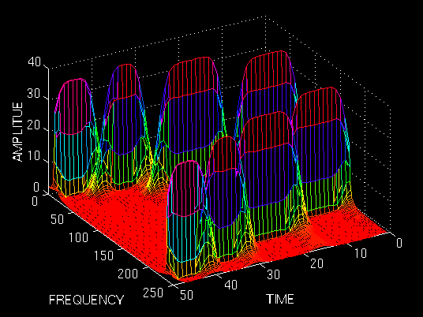
Example (cont’d)
scaled: t/20

Slide 30
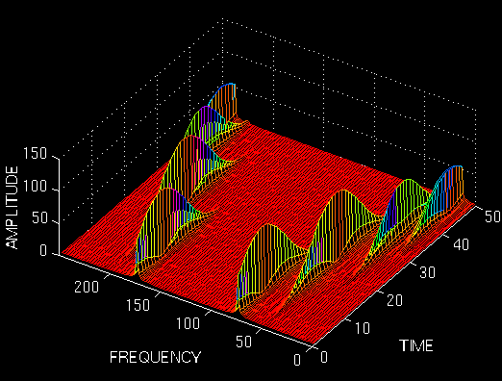
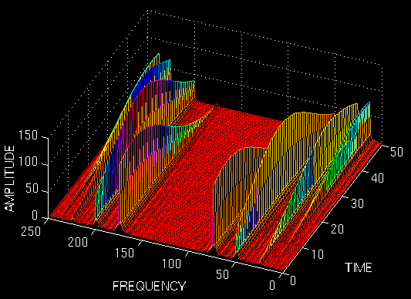
Example (cont’d)
scaled: t/20

Slide 31
Heisenberg (or Uncertainty) Principle
Time resolution: How well two spikes in time can be separated from each other in the frequency domain.
Frequency resolution: How well two spectral components can be separated from each other in the time domain

Slide 32
Heisenberg (or Uncertainty) Principle
We cannot know the exact time-frequency representation of a signal.
We can only know what interval of frequencies are present in which time intervals.

Slide 33
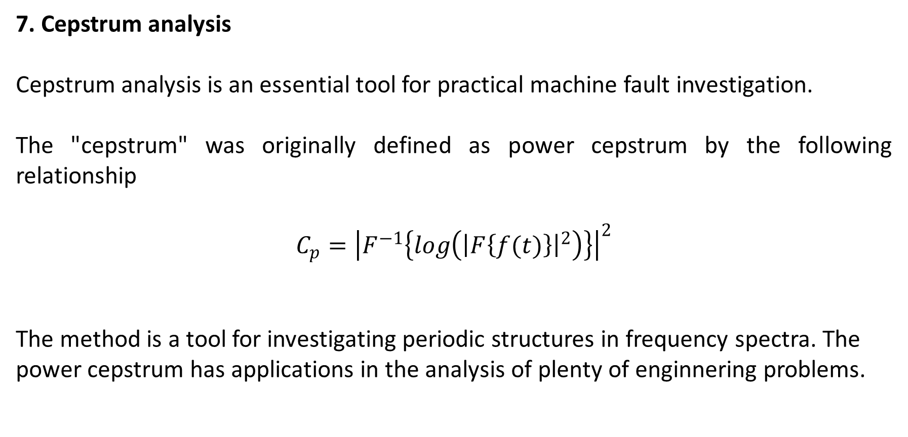
7. Cepstrum analysis
Cepstrum analysis is an essential tool for practical machine fault investigation.
The "cepstrum" was originally defined as power cepstrum by the following relationship
$$C_{p}={\left|F^{−1}\left\{log\left({\left|F\left\{f(t)\right\}\right|}^{2}\right)\right\}\right|}^{2}$$
The method is a tool for investigating periodic structures in frequency spectra. The power cepstrum has applications in the analysis of plenty of enginnering problems.

Slide 34
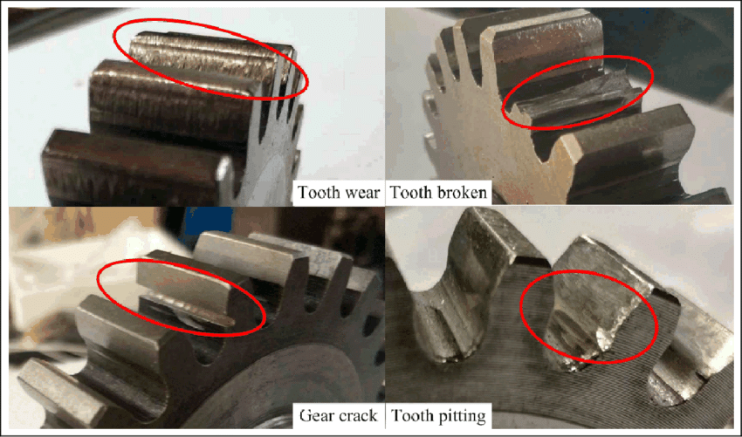
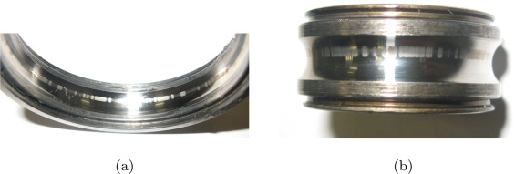
The concept of the cepstrum has led to numerous applications:
- machine vibration analysis based on harmonic patterns (gearbox faults, turbine blade failures,
- medical applications in analysis of electroencephalogram (EEG) and brain waves,
- dealing with reflection inference (radar, sonar applications, earth seismology)

Slide 35
7. Envelope Analysis
Envelope Analysis is the FFT (Fast Fourier Transform) frequency spectrum of the modulating signal.
Envelope Analysis can be used for diagnostics/investigation of machinery where faults have an amplitude modulating effect on the characteristic frequencies of the machinery.
Examples include faults in gearboxes, turbines and induction motors. Envelope Analysis is also an excellent tool for diagnostics of local faults like cracks and spallings in Rolling Element Bearings (REB).

Slide 36
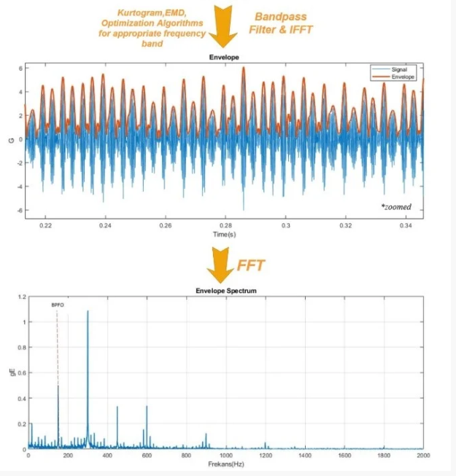
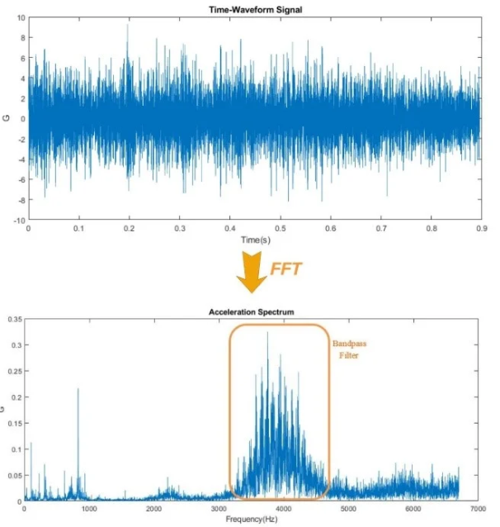

Slide 37
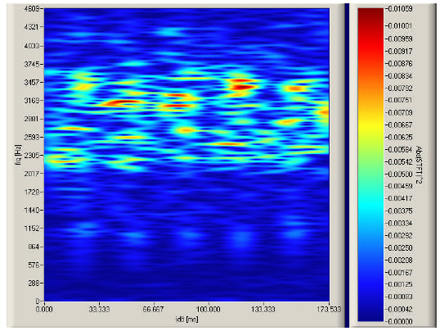
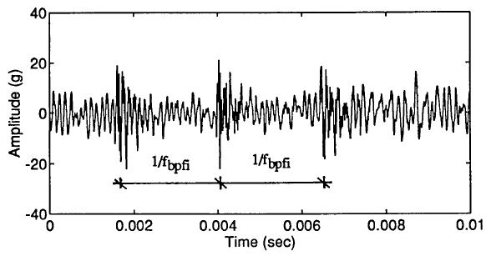

8-9-10. Wavelet transformation, MRA, scalograms
in Machine Fault Diagnostics
Evolution of wavelet transform:

Slide 38
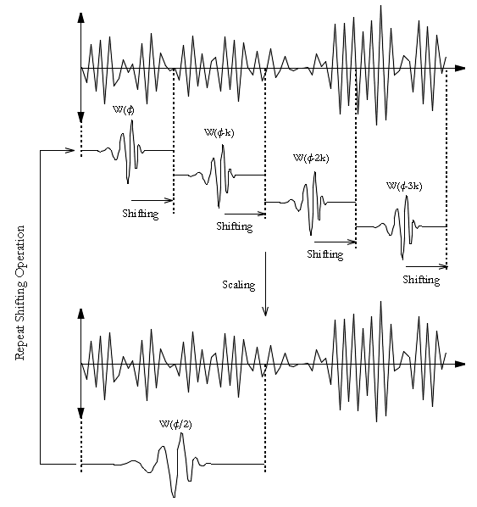
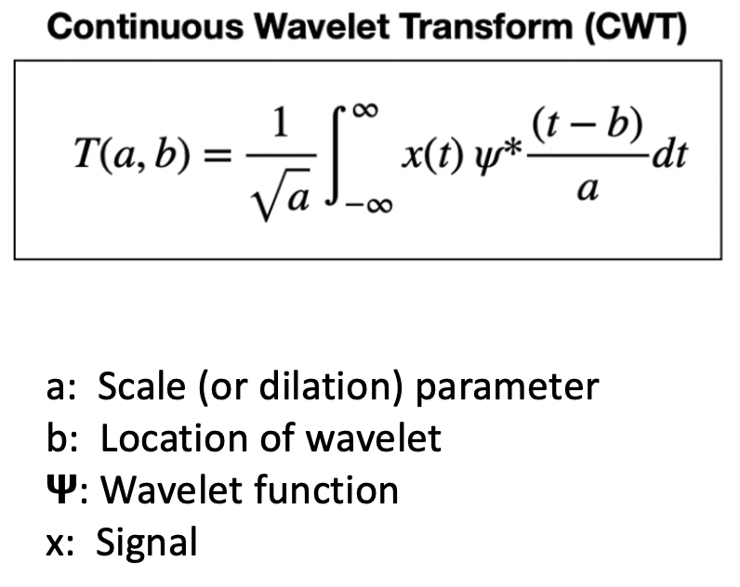
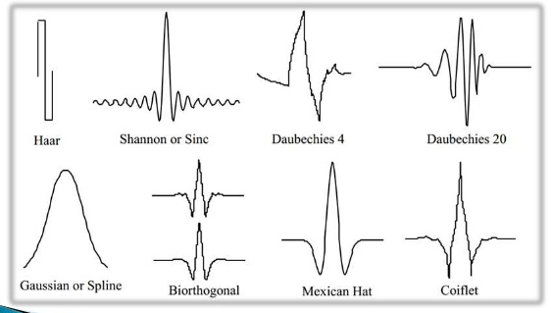

Slide 39
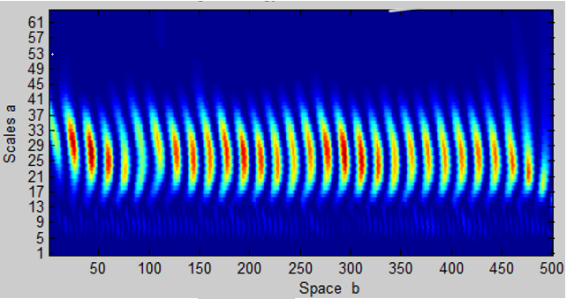
Scalogram as visual presentation of the wavelet coefficients

Slide 40

Some signals obviously have spectral characteristics that vary with time
Motivation

Slide 41
Criticism of Fourier Spectrum
It’s giving you the spectrum of the
‘whole time-series’
Which is OK if the time-series is stationary
But what if its not?
We need a technique that can “march along” a timeseries and that is capable of:
Analyzing spectral content in different places
Detecting sharp changes in spectral character

Slide 42

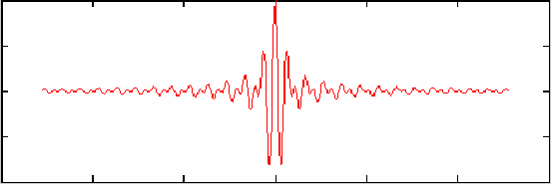
Fourier Analysis is based on an indefinitely long cosine wave of a specific frequency
time, t
Wavelet Analysis is based on an short duration wavelet of a specific center frequency
time, t

Slide 43
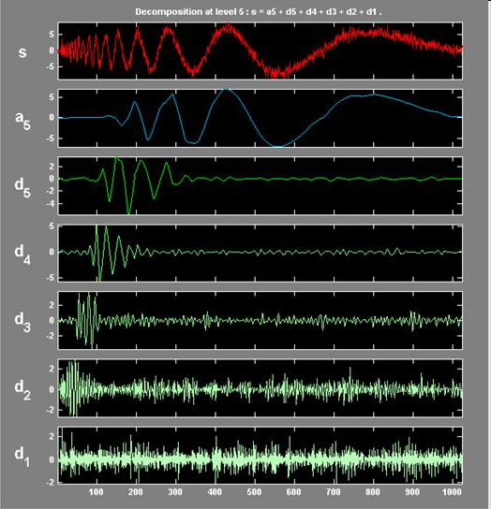
Multiresolution analysis by wavelets

Slide 44
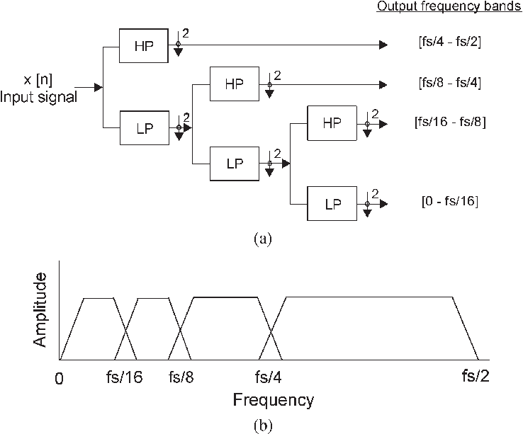
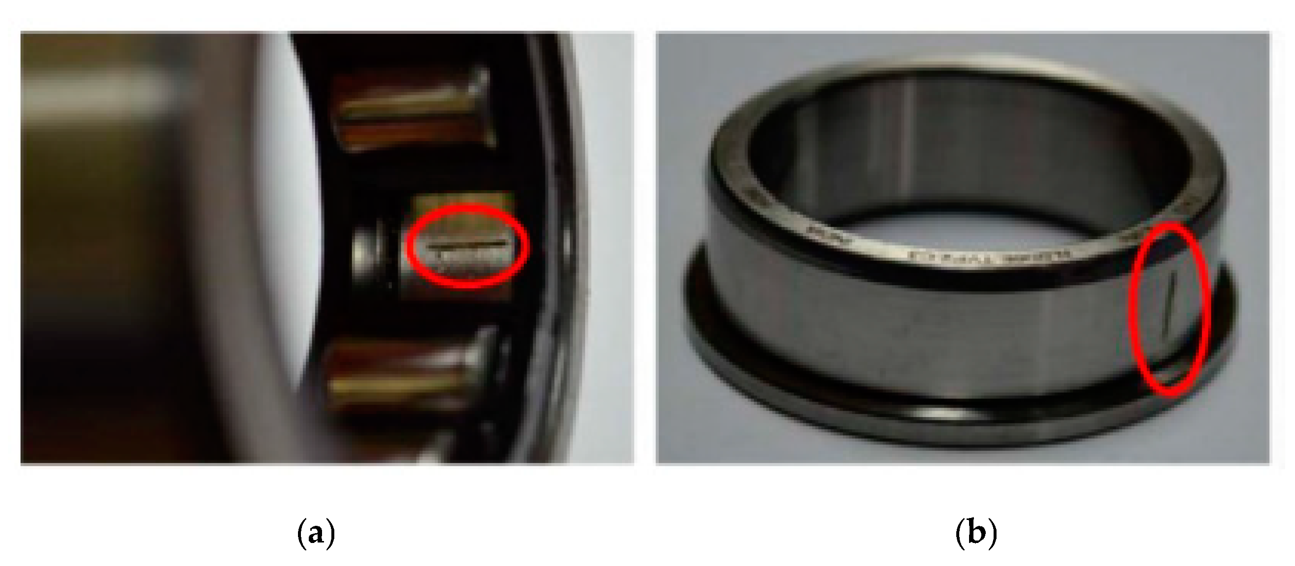
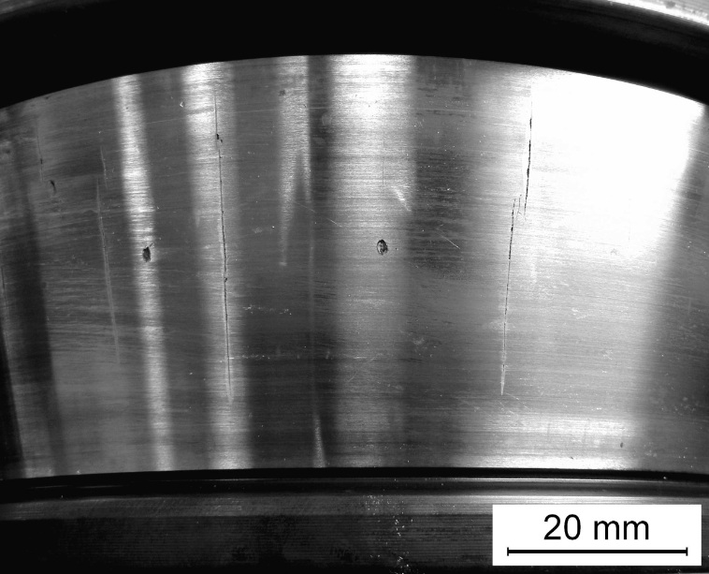
Multiresolution analysis:
Local fault and crack detection:

Slide 45
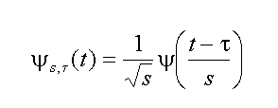
Wavelet
normalization
shift in time
change in scale:
big s means long wavelength
wavelet with
scale, s and time, τ
Mother wavelet

Slide 46
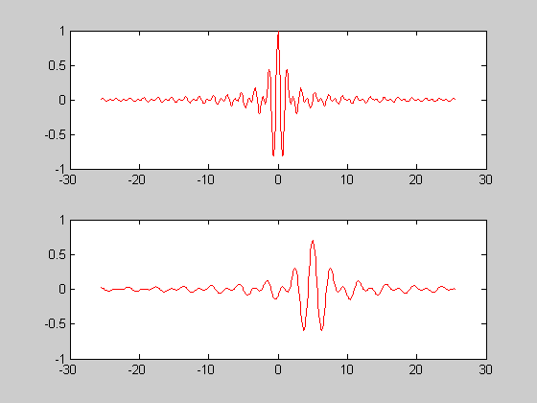
Shannon Wavelet
Ψ(t) = 2 sinc(2t) – sinc(t)
mother wavelet
τ=5, s=2
time

Slide 47
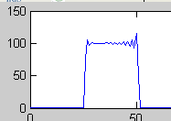

Fourier spectrum of Shannon Wavelet
frequency, ω
ω
Spectrum of higher scale wavelets

Slide 48

not any function, Ψ(t) will work as a wavelet
admissibility condition:
Implies that Ψ(ω)→0 both as ω→0 and ω→∞, so Ψ(ω) must be band-limited

Slide 49
Discrete wavelets: choice of scale and sampling in time
s^{j}=2^{j}
and
τ_{j,k} = 2^{j}kΔt
Then γ(σ_{j},t_{j,k}) = γ_{jk}
where j = 1, 2, …∞
k = -∞… -2, -1, 0, 1, 2, …∞
Scale changes by factors of 2
Sampling widens by factor of 2 for each successive scale

Slide 50
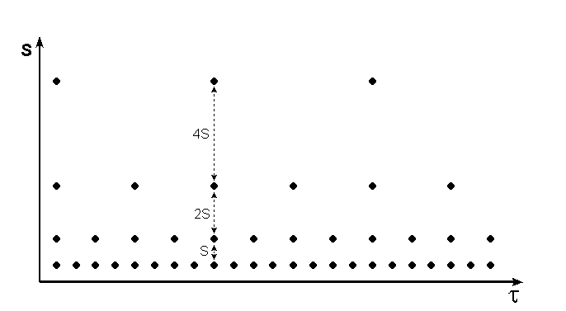
dyadic grid

Slide 51
The factor of two scaling means that the spectra of the wavelets divide up the frequency scale into octaves (frequency doubling intervals)
ω
¹/₈ω_{ny}
¼ω_{ny}
½ω_{ny}
ω_{ny}

Slide 52
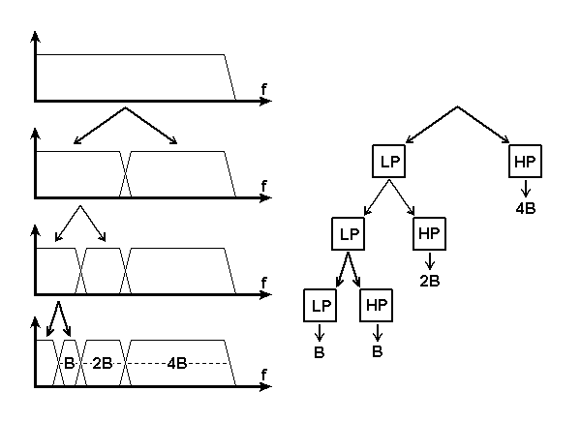
And then repeat the processes, recursively …

Slide 53
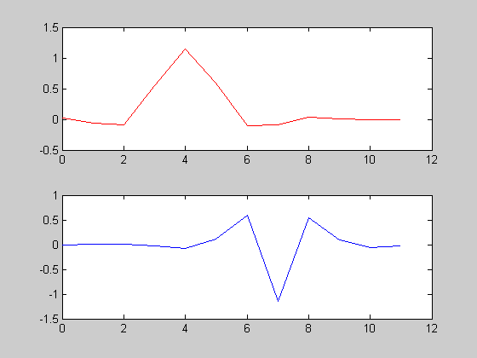
Coiflet low pass filter
time, t
Coiflet high-pass filter
time, t
From http://en.wikipedia.org/wiki/Coiflet

Slide 54
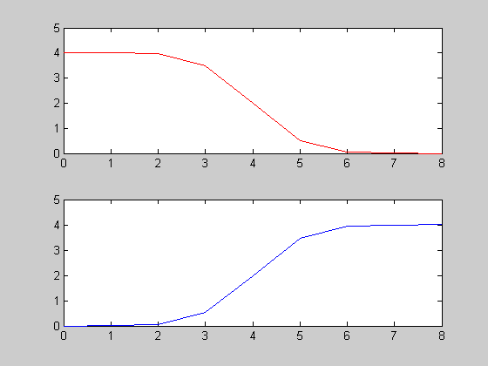
Spectrum of low pass filter
frequency, ω
Spectrum of wavelet
frequency, ω

Slide 55
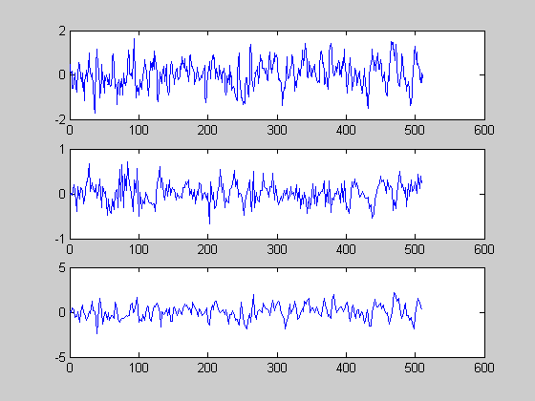
time-series
stage 1 - hi
stage 1 - lo

Slide 56
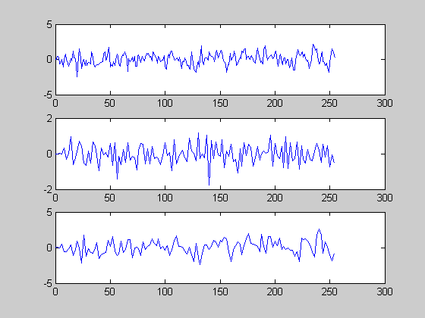
Stage 1 lo
stage 2 - hi
stage 2 - lo

Slide 57
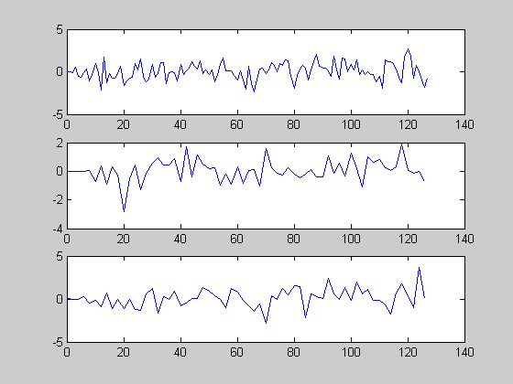
Stage 2 lo
stage 3 - hi
stage 3 - lo

Slide 58
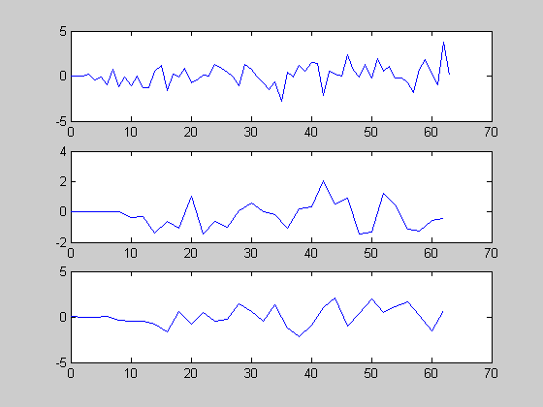
Stage 3 lo
stage 4 - hi
stage 4 - lo

Slide 59
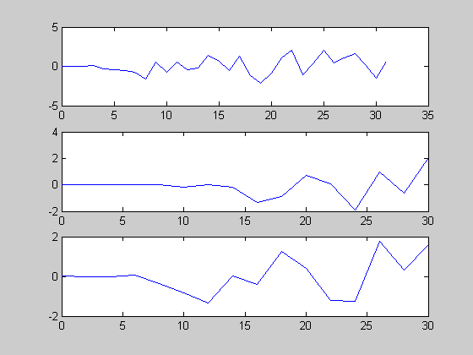
Stage 4 lo
stage 5 - hi
stage 6 - lo

Slide 60
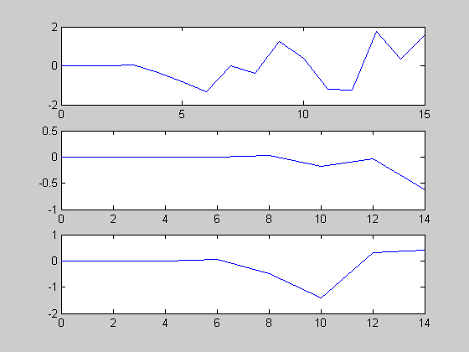
Stage 4 lo
stage 5 - hi
stage 6 - lo
Had enough?

Slide 61
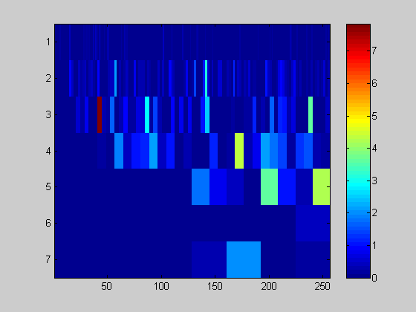

Putting it all together …
|γ(s_{j},t)|²
short
wavelengths
scale
long
wavelengths
time, t

Slide 62

LGA Temperature time-series
stage 1 - hi
stage 1 - lo

Slide 63


short
wavelengths
scale
long
wavelengths
time, t

Slide 64



Slide 65


Slide 66


Slide 67


Slide 68


Slide 69


Slide 70


Slide 71


Slide 72


Slide 73


Slide 74


Slide 75


Slide 76


Slide 77


Slide 78


Slide 79


Slide 80


Slide 81


Slide 82


Slide 83


Slide 84


Slide 85


Slide 86


Slide 87


Slide 88


Slide 89


Slide 90


Slide 91


Slide 92


Slide 93


Slide 94


Slide 95


Slide 97


Slide 99


Slide 100


Slide 101


Slide 102


Slide 103


IIR filters for digital signal processing:
These features should be changed for special purposes
which needs FIR filters instead of IIR ones.

Slide 104

FIR filters and filter design for special applications in fault diagnostics
FIR filter is designed by finding the coefficients and filter order that meet certain specifications, which can be in the time domain (e.g. a matched filter) and/or the frequency domain
Although IIR filters are useful but many times more specific filters are needed in the form of FIR filters which includes filter design to efficiently reveal the faults.

Slide 105





Experiment: practical FIR filter design in LABVIEW for engineering problem solution
$$BPFO=206.18 Hz,$$
$BPFI=287.15 Hz$, $FTF=12.88 Hz$, $BSF=89.96 Hz$ in this experiment at 1800 1/min in case of the No. 30205 bearing.
$$L_{OD}=π∙Δt∙D_{OI}∙FTF=1713.74∙Δt$$

Slide 106

Experiment : practical FIR filter design in LABVIEW for engineering problem solution

Slide 107


Experiment : practical FIR filter design in LABVIEW for engineering problem solution

Slide 108

Experiment: practical FIR filter design in LABVIEW for engineering problem solution

Slide 109
Data acquisition (DAQ)
Data acquisition is the process of sampling signals that measure real world physical conditions and converting the resulting samples into digital numeric values that can be manipulated by a computer. Data acquisition systems, abbreviated by the acronyms DAS or DAQ, typically convert analog waveforms into digital values for processing.
The components of data acquisition systems include:
Sensors, to convert physical parameters to electrical signals.
Signal conditioning circuitry, to convert sensor signals into a form that can be converted to digital values.
Analog-to-digital converters, to convert conditioned sensor signals to digital values.

Slide 110


Slide 111
Data acquisition begins with the physical phenomenon or physical property to be measured. Examples of this include temperature, light intensity, gas pressure, fluid flow, and force. Regardless of the type of physical property to be measured, the physical state that is to be measured must first be transformed into a unified form that can be sampled by a data acquisition system.
The task of performing such transformations falls on devices called sensors. A data acquisition system is a collection of software and hardware that allows one to measure or control physical characteristics of something in the real world. A complete data acquisition system consists of DAQ hardware, sensors and actuators, signal conditioning hardware, and a computer running DAQ software.
A sensor, which is a type of transducer, is a device that converts a physical property into a corresponding electrical signal (e.g., strain gauge, thermistor). An acquisition system to measure different properties depends on the sensors that are suited to detect those properties. Signal conditioning may be necessary if the signal from the transducer is not suitable for the DAQ hardware being used. The signal may need to be filtered or amplified in most cases. Various other examples of signal conditioning might be bridge completion, providing current or voltage excitation to the sensor, isolation, linearization.

Slide 112


Slide 113
DAQ hardware is what usually interfaces between the signal and a PC.^{[6]} It could be in the form of modules that can be connected to the computer's ports (parallel, serial, USB, etc.) or cards connected to slots (S-100 bus, AppleBus, ISA, MCA, PCI, PCI-E, etc.) in the motherboard. Usually the space on the back of a PCI card is too small for all the connections needed, so an external breakout box is required. The cable between this box and the PC can be expensive due to the many wires, and the required shielding.
DAQ cards often contain multiple components (multiplexer, ADC, DAC, TTL-IO, high speed timers, RAM). These are accessible via a bus by a microcontroller, which can run small programs.
DAQ software
Specialized DAQ software may be delivered with the DAQ hardware. Software tools used for building large-scale data acquisition systems include EPICS. Other programming environments that are used to build DAQ applications include ladder logic, Visual C++, Visual Basic, LabVIEW, and MATLAB.

Slide 114

A sensor is a transducer that receives and responds to a signal or stimulus from a physical system.^{[3][4][2]} It produces a signal, which represents information about the system, which is used by some type of telemetry, information or control system.

Slide 115
Characteristics of sensors
Dynamic range: This is the ratio between the largest amplitude signal and the smallest amplitude signal the transducer can effectively translate.^{[2]} Transducers with larger dynamic range are more "sensitive" and precise.
Repeatability: This is the ability of the transducer to produce an identical output when stimulated by the same input.
Noise: All transducers add some random noise to their output. In electrical transducers this may be electrical noise due to thermal motion of charges in circuits. Noise corrupts small signals more than large ones.
Hysteresis: This is a property in which the output of the transducer depends on not only its current input but also its past input. For example, an actuator which uses a gear train may have some backlash, which means that if the direction of motion of the actuator reverses, there will be a dead zone before the output of the actuator reverses, caused by play between the gear teeth.

Slide 116


Slide 117


Slide 118


Slide 119


Slide 120


Slide 121


Slide 122


Signal-to-noise ratio
Signal-to-noise ratio (abbreviated SNR or S/N) is a measure used in science and engineering that compares the level of a desired signal to the level of background noise. SNR is defined as the ratio of signal power to the noise power, often expressed in decibels. A ratio higher than 1:1 (greater than 0 dB) indicates more signal than noise.

Slide 123
Improving SNR in practice
All real measurements are disturbed by noise. This includes electronic noise, but can also include external events that affect the measured phenomenon — wind, vibrations, gravitational attraction of the moon, variations of temperature, variations of humidity, etc., depending on what is measured and of the sensitivity of the device. It is often possible to reduce the noise by controlling the environment. Otherwise, when the characteristics of the noise are known and are different from the signals, it is possible to filter it or to process the signal.
For example, it is sometimes possible to use a lock-in amplifier to modulate and confine the signal within a very narrow bandwidth and then filter the detected signal to the narrow band where it resides, thereby eliminating most of the broadband noise. When the signal is constant or periodic and the noise is random, it is possible to enhance the SNR by averaging the measurement.
When a measurement is digitized, the number of bits used to represent the measurement determines the maximum possible signal-to-noise ratio. This is because the minimum possible noise level is the error caused by the quantization of the signal, sometimes called Quantization noise.

Slide 124



Slide 125

Typical Bode Diagrams

Slide 126

Envelope-analysis and examples for bearing fault detection

Slide 127


Slide 128


Slide 129


Slide 130


Slide 131


Slide 132



Bearing damages caused by fatigue

Slide 133


Slide 134


Slide 135


Slide 136


Slide 137


Slide 138


Slide 139


Slide 140


Digital measurement and aliasing

Slide 141


Slide 142


Slide 143



Slide 144

Fault frequencies of roller bearings in time domain

Slide 145


Slide 146


Slide 147


Slide 148


Slide 149


Slide 150


Slide 151


Slide 152


Slide 153


Slide 154


Conclusion
All of these applications for the Students have a significant role in the field of mechanical engineering as the part of practical machine fault analysis to reveal problems and find practical optimal solutions how to mitigate them.

Slide 155
Example exercise (out of the total 3 exercises in this chapter)
Use the echo detection application in MATLAB. Create a 45 Hz sine wave sampled at 100 Hz. Add an echo of the signal, with half the amplitude, 0.2 seconds after the beginning of the signal.
Compute and plot the complex cepstrum of the new signal.
Solution
t = 0:0.01:1.27;
s1 = sin(2*pi*45*t);
s2 = s1 + 0.5*[zeros(1,20) s1(1:108)];
c = cceps(s2);
plot(t,c)

Slide 156


